Slide 1

Analysis of Twitter Sentiments Using Spark Streaming
Dishant Fapot
Manisha Tirunahari
Vittal Miskin

Slide 2
Objective
The goal is to connect to Twitter data, look for tweets containing a specific term or hashtag, and assess whether those tweets are positive, negative, or neutral in tone.³

Slide 3
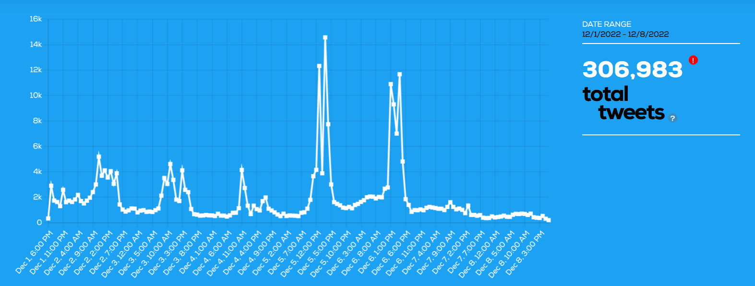
Number of Tweets
Source: Tweet Binder

Slide 4
Agenda
Data Collection
Data Organization
Data Analyzation
Data Visualization

Slide 5
Data Collection
Tweepy is our primary data source; this is a library in python which allows users to use Twitter API. The following are the steps that are followed to access Twitter API:¹
Initially, we created a developer account on Twitter
Created a project “SentaAMulti”
This project was updated to elevated access as our code was unsatisfied with the requirements. Earlier, we had essential access, which only accepts 500k tweets per month, and this elevated access allows up to 2M tweets per month
Now, the final step is to collect the required keys.

Slide 6
Data Organization
In organizing data, we focus on cleaning and preprocessing data and using it for required purposes.² The following are the points that involving in organizing data:
Planning
Architecture
Implementation

Slide 7
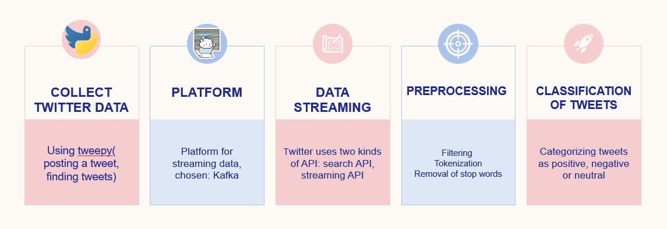
Plan of Streaming

Slide 8
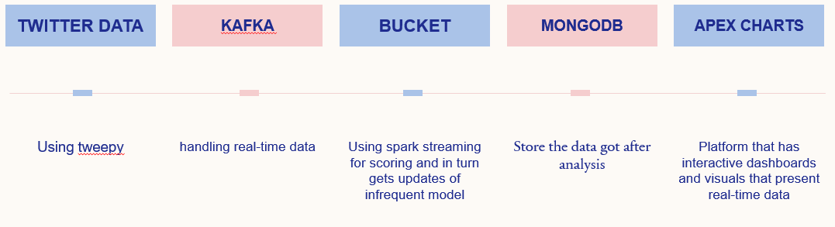
Architecture

Slide 9
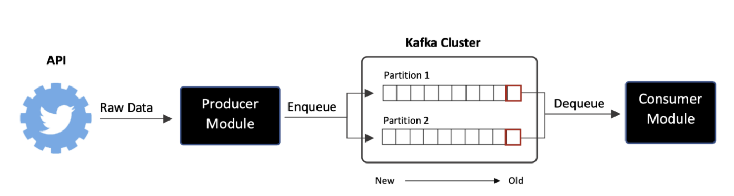
Using Kafka Streaming

Slide 10
Analyzing Data
We have TextBlob to classify our data. TextBlob is a lexical-based sentimental analysis algorithm for calculating polarity based on its weight dictionary. Textblob is a natural language toolkit-based Python NLP package (NLTK). It uses NLTK because it is easy to use, and deploy, consumes fewer resources, provides dependency parsing, and can be applied to even small applications. Working with text data and performing complicated analyses are both possible with Textblob. Textblob produces polarity and subjectivity as its two outputs after receiving a sentence.⁶
Polarity output lies between [-1,1]
-1 refers to negative sentiment
0 refers to neutral sentiment.
+1 refers to positive sentiment.
Subjectivity output lies within [0,1], which refers to personal judgments and opinions.

Slide 11
Implementation
Choosing of data:
req_fields = "tweet.fields=text"
We require only text of the tweets.
Preprocessing of data:
# Removing link
tweet = re.sub(r'http\S+', '', str(tweet))
tweet = re.sub(r'bit.ly/\S+', '', str(tweet)
tweet = tweet.strip('[link]’)
# Removing puntuations
my_punctuation = '!"$%&\'()*+,-./:;<=>?[\\]^_`{|}~•@â
tweet = re.sub('[' + my_punctuation + ']+', ' ', str(tweet))
Classification of tweets:
from textblob import TextBlob
TextBlob is a lexical-based sentimental analysis algorithm that uses NLTK for calculating polarity. (I.e.based on its weight dictionary.)

Slide 12
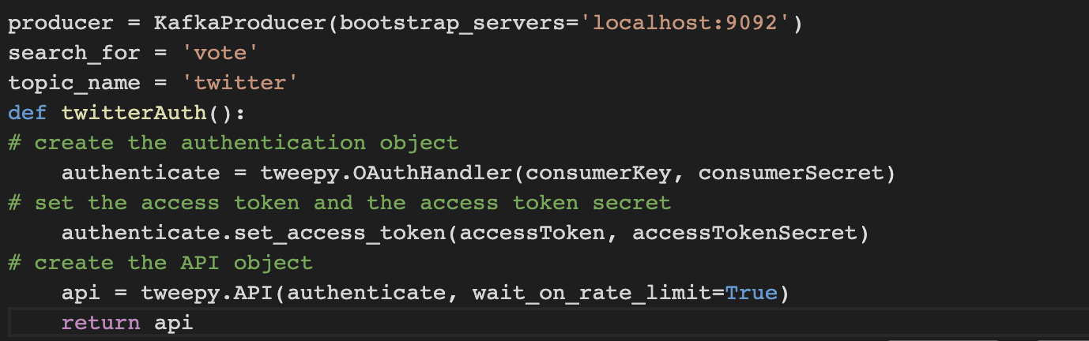
Steps
Creating Kafka Producer:

Slide 13
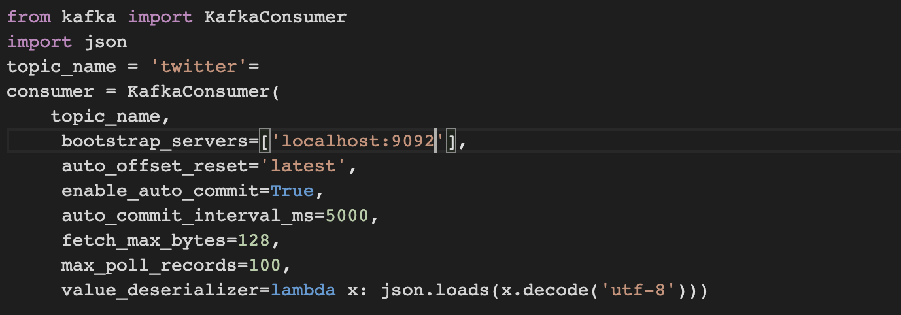
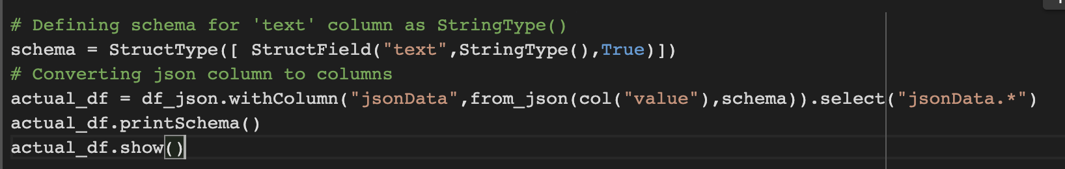
Creating Kafka Consumer:
Streaming:
Schema:

Slide 14
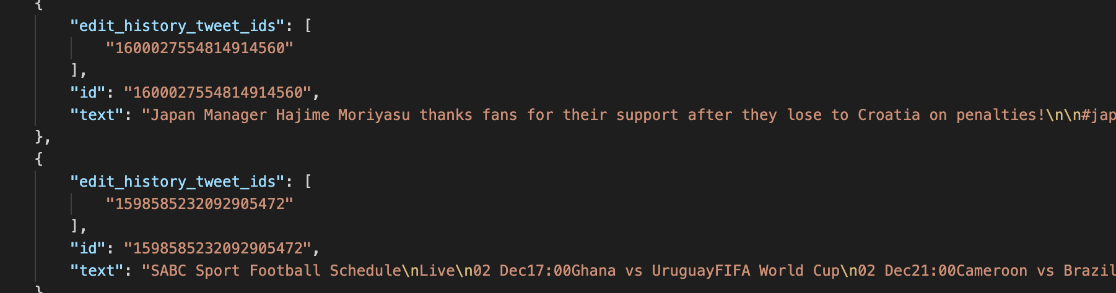
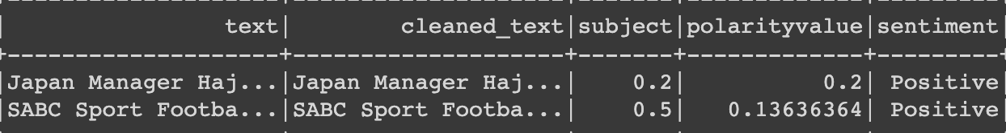
Glimpse of JSON files:
After the processing, the text column:

Slide 15
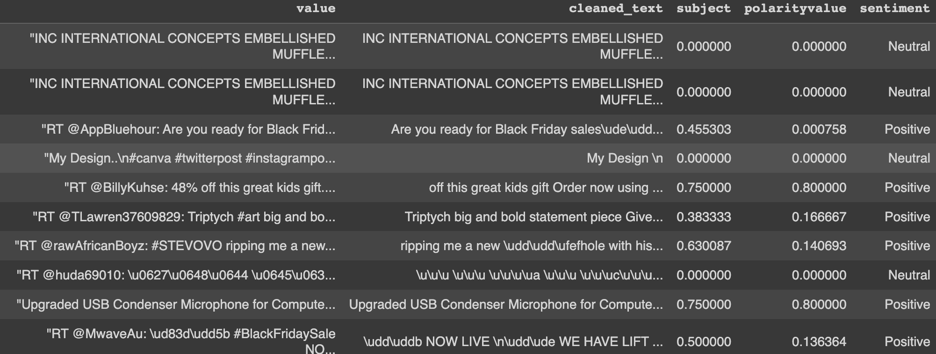
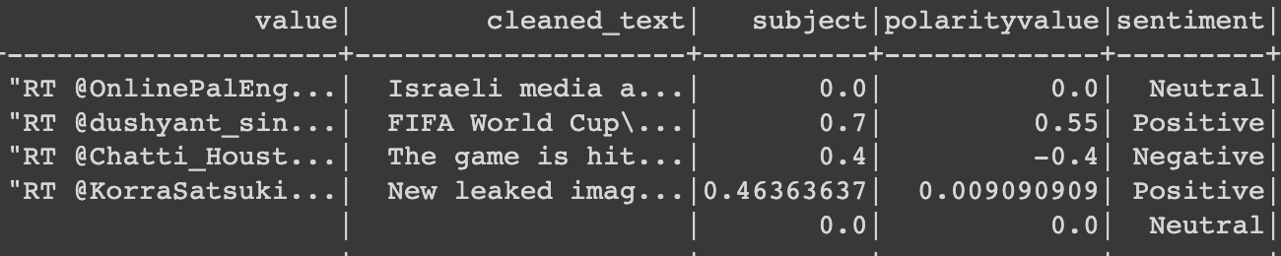
Results

Slide 16
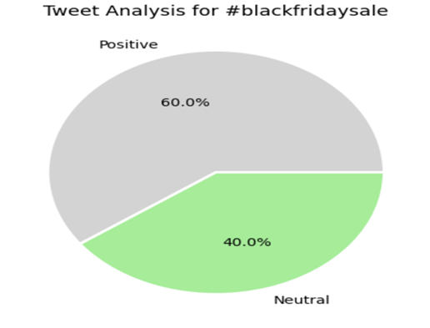
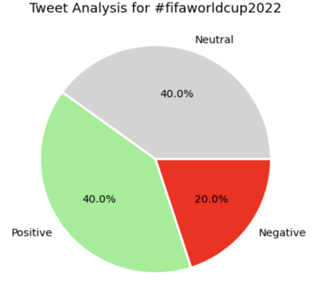

Slide 17
Conclusion
We proposed an efficient sentimental analysis technique using pyspark machine learning library to execute different algorithms.
Lastly, during the implementation, we gained in-depth knowledge in field of big data analytics. We got to explore tools like Power BI and Tableau which are used wide across the technological companies.

Slide 18
Future Scope
Explore a new approach to sentiment classification based on integrating Deep Learning Libraries with the Apache Spark platform.⁷
With help of this real time data, use different features to enhance the accuracy of data.

Slide 19
References
https://www.hindawi.com/journals/wcmc/2021/3920325/
https://medium.com/@lorenagongang/sentiment-analysis-on-streaming-twitter-data-using-kafka-spark-structured-streaming-python-part-b27aecca697a
https://www.bmc.com/blogs/working-streaming-twitter-data-using-kafka/
https://scholarworks.calstate.edu/downloads/db78tc01m
https://www.linkedin.com/pulse/real-time-twitter-sentiment-analysis-via-kafka-spark-streaming-fang
https://traintestsplit.com/twitter-sentiment-analysis-in-python-with-code/
https://ceur-ws.org/Vol-1558/paper41.pdf
https://dash.tweetbinder.com/report/free

Slide 20
Thank you

